Slide 1
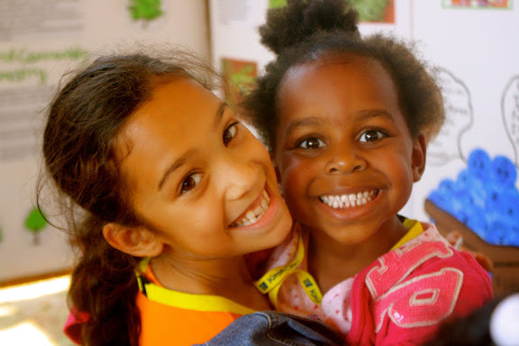
Kate’s Club
Empowering children facing life after the death of a parent or sibling

Slide 2
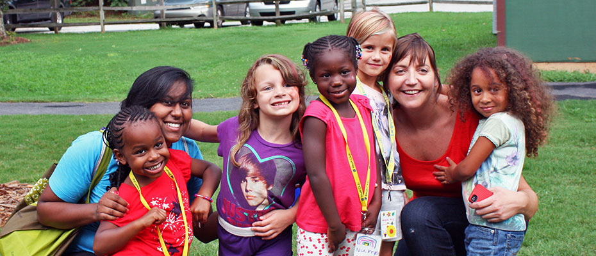
Mission Statement
Kate’s Club empowers children facing life after the death of a parent or sibling. We build healing communities through recreational and therapeutic group programs, education, and advocacy.

Slide 3
1 in 20 kids will lose a parent or sibling before age 18
Risks of Unaddressed Grief What Helps
Depression
Anxiety & Guilt
Poor school performance
Anger & Aggression
Substance Abuse
Isolation
Expressing emotions
Sharing memories
Developing coping skills
Friends who “get it”
Permission to “just be a kid”

Slide 4
Scope of the Issue
According to widely accepted national studies, 1 in 20 children (5%) will experience the death of a parent or sibling before the age of 18.
With over 1.5 million children in the 29 county Metro Atlanta Region (MSA), an estimated 76,000 will be effected by the death of a parent or sibling. In the 5 central metro counties alone (Fulton, Dekalb, Cobb, Gwinnet and Clayton), this number is almost 45,000.

Slide 6

Kate’s Club Approach
Vision: A world in which it is OK to grieve.
Community
Safety
Long-term support
Fun

Slide 7
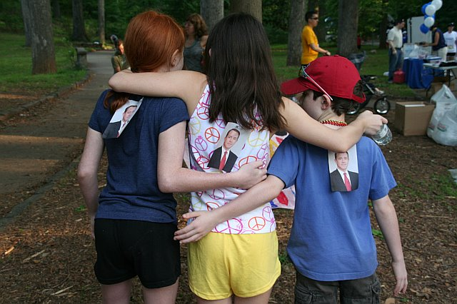
Programming at Kate’s Club
Our doors are open to HOPE, COMMUNITY, & FUN
For the kids (5-18)
Monthly Clubhouse Days
Quarterly Club Outings
Camp Good Mourning
KC Connects
For the parents
Park Bench
Holiday H.U.G.S.
Memory Walk
Kate’s Club programs are free to grieving children and their families. 100% of our funding is from charitable donations.

Slide 8
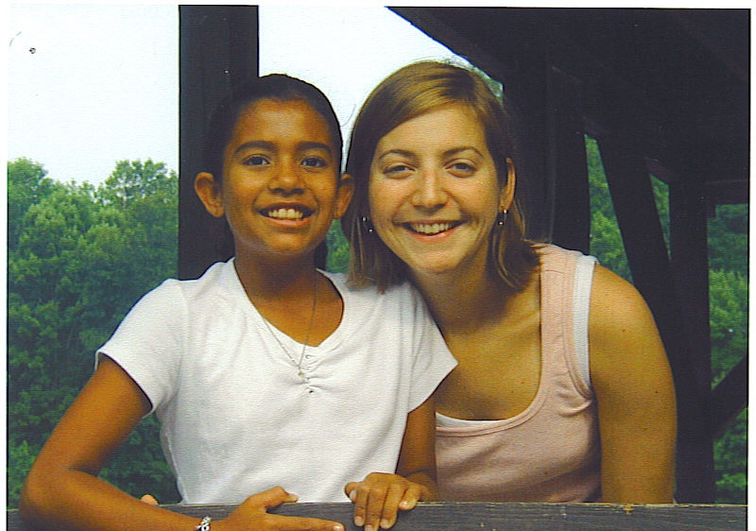
Kate Atwood, Founder
Kate lost her mother to breast cancer when she was 12 year’s old.
While volunteering for a bereavement camp, Kate was asked to share her story.
Kate started Kate’s Club as a 23 year old by taking 6 kids bowling.

Slide 9
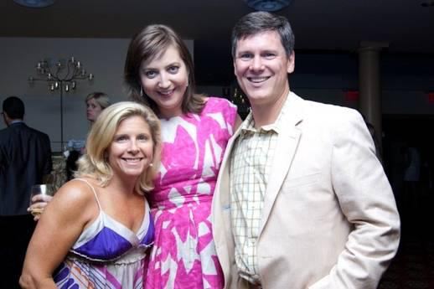
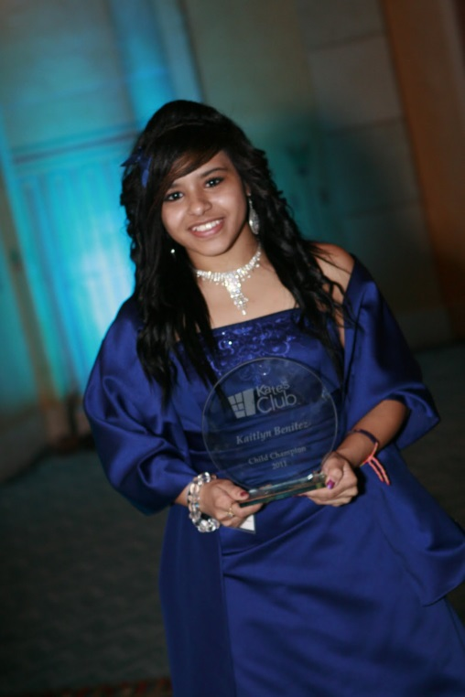
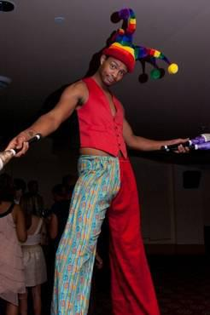
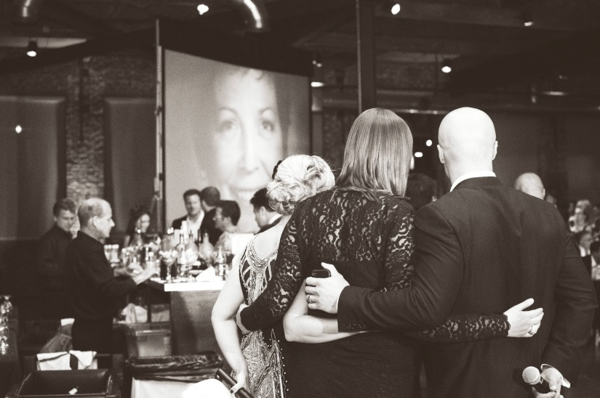
Special Events
Kate’s Club traditionally had two main special events – Dinner of Champions, and Cabaret.
In 2013, we transitioned to The Spirit of Kate’s Club Gala.

Slide 10
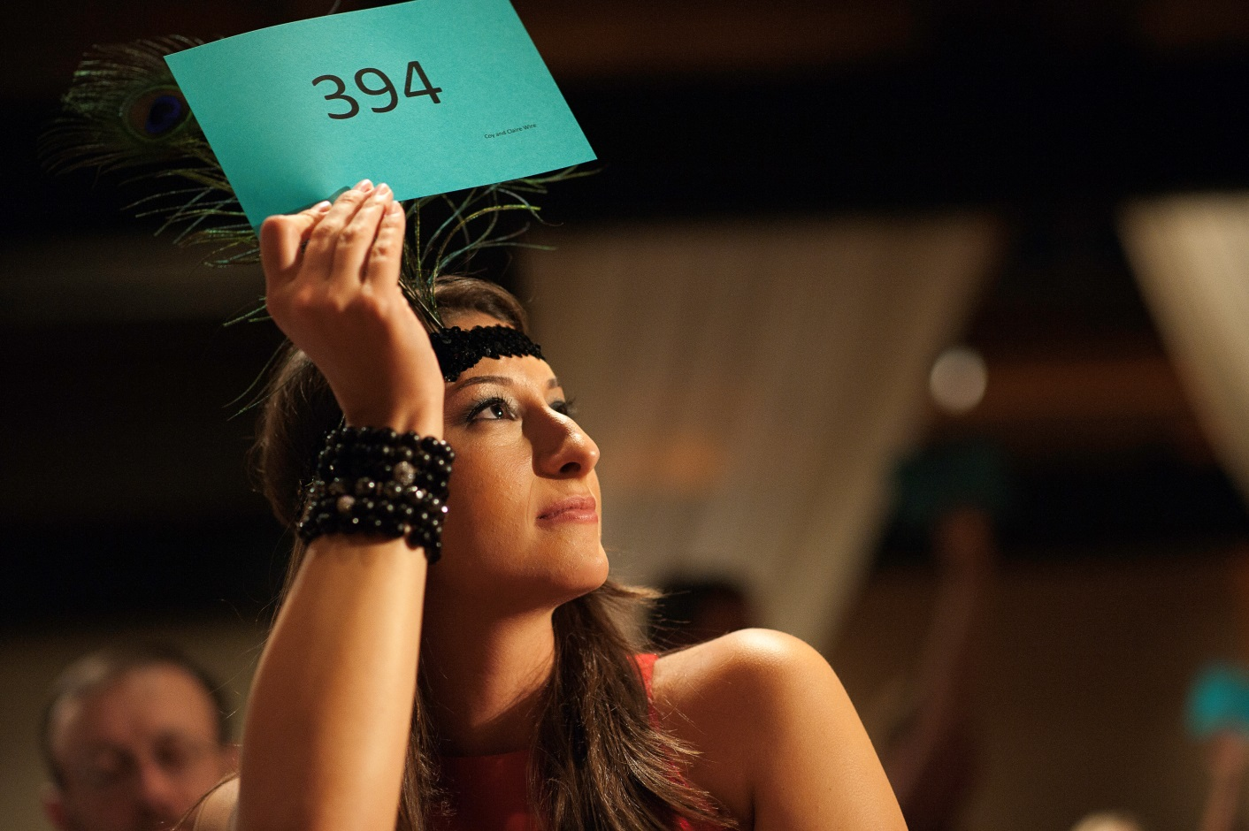
Changing for the Better and Evaluating our ROI
Are our special events reflective of the Kate’s Club community?
Are we using staff and volunteer resources effectively?
Are we maximizing fundraising potential of our special events?

Slide 11
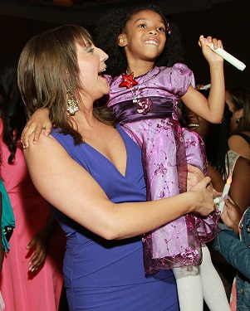
Leap of Faith
The 10th Anniversary Gala had a record 620 patrons.
$270,000+ raised in support of Kate’s Club programming.
Well crafted program designed to engage and celebrate Kate’s Club.

Slide 12
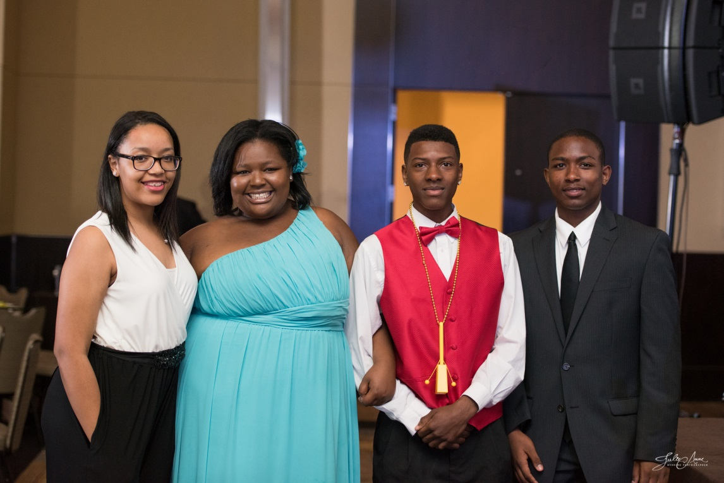
Keys to Our Success
Large Event Committees
Well-defined goals
Maintaining Momentum
Never underestimate the donor experience.
Being willing to make needed changes.

Slide 13
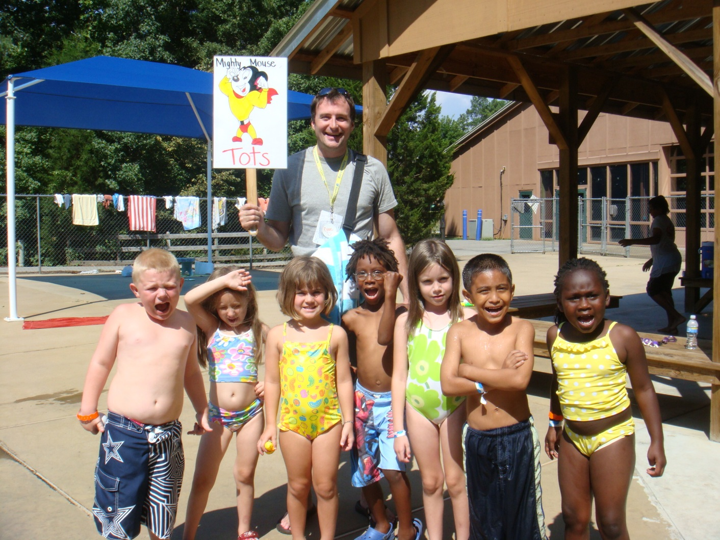
Mission Based Fundraising
Staying True to Your Mission
Events should be reflective of your mission and constituents. Make the night meaningful by incorporating your mission in a positive way.

Slide 14
The Art of the Paddle Raise
Best Tips
Meaningful funding levels.
Relatable to patrons.
Be willing to challenge yourself.
Be prepared by communicating with donors ahead of time.
Consider a professional auctioneer.
Have well trained volunteers.
Have a plan of execution in place.

Slide 15

Program Costs
$2,500 – Enables a child and his or her family for an entire year of Kate’s Club
$1,000 – Sponsors a Club Outing for 100 children
$500 – Makes it possible for a child to attend Camp Good Mourning
$250 - Funds a KC Connects Support Group at a school
$100 – Covers a child at a Clubhouse Saturday or Sunday Program

Slide 16
Funding
100% of Kate’s Club’s annual operating budget is raised each year through charitable contributions.
Kate’s Club charges no tuition or fees to grieving children and their families, but most choose to become donors.
2015 annual budget is $750,000.
80% of spending is on direct program expenses
Budget has been growing 15-20% each year to keep pace with demand for services

Slide 17
Funding, by Source

Slide 18
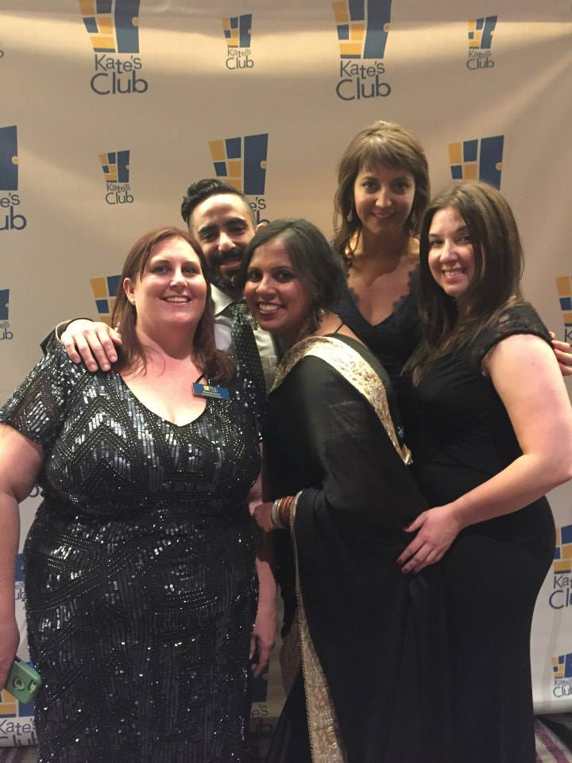
The Final Result
Increased fundraising – greater ROI on money spent
Enhanced the patron experience
Raised the profile of Kate’s Club in the community
Had FUN!

Slide 19
THANK YOU!
Kate’s Club
404-347-7619
Rachel.ezzo@katesclub.org
www.katesclub.org
Twitter: @katesclub
Facebook: KatesClubInc.

