Slide 1
Engagement Due Diligence
Steps to Minimize Risks and Maximize Rewards
Debra Scott, JD, MPH SP Consulting, a Division of The Scott Practice, LLC

Slide 2
Presentation Agenda
Inherent Risks Involved With Service Engagements
Measuring Risks and Analytical Procedures
How To Conduct Due Diligence of text goes here
Engagement Agreements to Minimize Risks line of text goes here
www.scottpractice.com

Slide 3
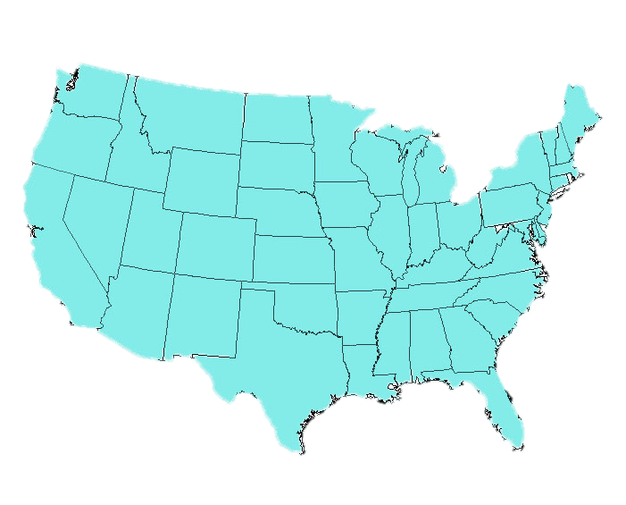
Why Due Diligence?
www.scottpractice.com

Slide 4
Why Due Diligence?
www.scottpractice.com

Slide 5
Why Due Diligence?
www.scottpractice.com

Slide 6
Why Due Diligence?
www.scottpractice.com

Slide 7
Inherent Risks of Nonpayment
Service Provider’s Side
Buyer’s Side
For service providers, there is a risk of nonpayment – meaning the provider does not receive payment for her services.
On the buyer’s side there is a risk of nonperformance – meaning the buyer does not receive the services bargained for under the contract.
There are risks involved in every agreement for performance of services. We will focus on the risk of nonpayment in today’s discussion

Slide 8
Inherent Risks of Nonpayment
Unless the agreement requires all payment upfront – the contractor accepts some form a credit risks when he or she agrees to provide services to the buyer.
Credit risks:
probability
fail to meet his or her obligations
default on the agreed upon term
www.scottpractice.com

Slide 9
Inherent Risks of Nonpayment
The level of inherent risk (level of risk before considering controls) that a service provider faces with respect to nonpayment for services may depend on a number of factors – but the largest factor will be the parties involved in the transaction.
www.scottpractice.com

Slide 10
Inherent Risks of Nonpayment
First identify what is the inherent risk involved when you are contemplating entering into a relationship with the other party.
Inherent risks is the level of risk prior to assessing the effectiveness of controls. It shows the level of risk that exists if no controls are present.
Without acknowledging the inherent risk it is difficult to properly create effective controls to mitigate risks.
www.scottpractice.com

Slide 11
What could go wrong?
What’s the impact?
What’s the likelihood?

Slide 12
Risk Identification
Jane Agrees to Purchase Eggs from Tom for $1K?
What Could Go Wrong?
No Meeting of Minds
Inability to Deliver
Bad Management
Strike
Acts of God
3. Poor Financial Position
4. Fraud
www.scottpractice.com

Slide 13
Risk assessment
Jane Agrees to Purchase Eggs from Tom for $1K?
How Likely Is It? How About Consequences?
No Meeting of Minds
Inability to Deliver
Bad Management
Strike
Acts of God
3. Poor Financial Position
4. Fraud
www.scottpractice.com

Slide 14
Risk assessment
How Likely Is it?
Likelihood Scale
Probability of Event | Years in Operations
High | >0-2
Medium | >2-5
Low | >5
www.scottpractice.com
Notes:
6

Slide 15
Risk assessment
What is the Impact?
Consequence Scale
Degree of Impact | Bad Debt
Significant | ≥$10k
Average | ≥$3k-$10k
Slight | < $3k
www.scottpractice.com
Notes:
6

Slide 16
Risk assessment
Our Assessment of the Risk?
Significant Receivable
Inexperienced
 | Slight | Average | Significant
Low | Trivial Risk | Acceptable Risk | Elevated Risk
Medium | Acceptable Risk | Elevated Risk | Substantial Risk
High | Elevated Risk | Substantial Risk | Unacceptable Risk
www.scottpractice.com
Notes:
6

Slide 17
Risk assessment
 | Slight | Average | Significant
Low | Trivial Risk | Acceptable Risk | Elevated Risk
Medium | Acceptable Risk | Elevated Risk | Substantial Risk
High | Elevated Risk | Substantial Risk | Unacceptable Risk
Trivial | Lowest Level Controls | Boilerplate Agr/No Retainer
Acceptable | Additional Controls | Boilerplate Agr/Retainer
Elevated | Higher/Customized Controls | Draft Agr and Retainer
Substantial | Considerable Controls | Draft Agr and High Retainer
Unacceptable | No Engagement | No Engagement
www.scottpractice.com
Notes:
6

Slide 18
Risk assessment
Acceptable Risk
Elevated Risk
Customized Controls
$$
Acceptable Risk
www.scottpractice.com
Notes:
6

Slide 19
Risk assessment
Acceptable Risk
Substantial Risk
Considerable Controls
$$$
Acceptable Risk
www.scottpractice.com
Notes:
6

Slide 20
Risk assessment
Acceptable Risk
We need to determine our level of acceptable risk.
The lower our acceptable risk, the more controls we will need to put into place to reach that acceptable risk.
The higher the level of risk, the more controls are needed to reduce that risk.
Unmitigated Risk
Proper Controls
Acceptable Risk
www.scottpractice.com
Notes:
6

Slide 21
Risk Controls
Due Diligence
Need for Information
Need to know more about the risk probabilities based upon our due diligence.
More information gives us better judgment regarding the risk and the probability of occurrence.
Without proper due diligence we may intuitively make decisions that cost us in the long-run.
www.scottpractice.com
Notes:
6

Slide 22
Risk Controls
Due Diligence
Screening Process
Prior Relationships
Who has the client worked with in the past? Why is he/she not working with prior contractor for this engagement?
Has the client engaged others for the same work? If so, what were the client’s expectations?
Has the client been a plaintiff/defendant in a prior lawsuit? (optional)
Has the client refused to pay legitimate fees in the past? (optional))
www.scottpractice.com
Notes:
6

Slide 23
Risk Controls
Due Diligence
Screening Process
Unreasonable Expectations
Are there impending deadlines or strict time limitations?
Are the client’s goals achievable?
Does the client equate payment contingent on any outcome?
Does client appreciate the time involved?
Does the client possess unreasonable expectations regarding the outcome?
www.scottpractice.com
Notes:
6

Slide 24
Risk Controls
Due Diligence
Screening Process
Financial History and Form 990
Contractors Hired in Past & Average Fee (optional)
Average Salary Paying Employees
Compare Salary of Highest Paid Officers to Other Staff
www.scottpractice.com
Notes:
6

Slide 25
Risk Controls
Due Diligence
Screening Process
Financial Statements
Can the Executive Director provide a current balance sheet (Statement of Financial Position) and income statement (Statement of Activities)?
Balance Sheet/Income Statement: Was it prepared using Accounting Software?
Balance Sheet: Does the organization have a sufficient cash reserve to cover expenses?
Income Statement: Is the bottom line positive? Is there enough income to cover expenses?
www.scottpractice.com
Notes:
6

Slide 26
Risk Controls
Due Diligence
Screening Process
Evidence of Dishonesty or Lack of Integrity
Public Records Search
Criminal Records Search
Bankruptcy, Tax Liens
Civil Court Records
Business Credit Review
National Newspaper Archives
www.scottpractice.com
Notes:
6

Slide 27
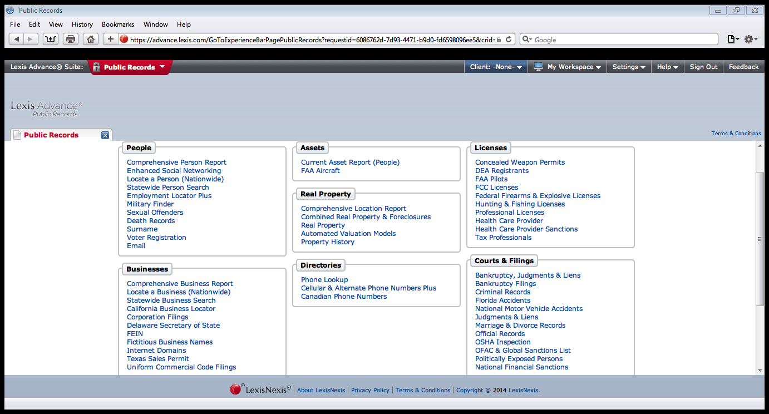
Risk Controls
Public Records Search
Due Diligence
Screening Process
Evidence of Dishonesty or Lack of Integrity
www.scottpractice.com
Notes:
6

Slide 28
Risk Controls
Due Diligence
Screening Process
Evidence of Dishonesty or Lack of integrity
Public Records Search
Personal Records
Payment History (optional)
Management Experience (verify)
Personal References (Known by Others in Industry)
www.scottpractice.com
Notes:
6

Slide 29
Risk Controls
Due Diligence
Investigate Red Flags
Prior record of legal actions – overly litigious means not afraid to sue or there is a high risk of non-payment or someone who does not honor their agreements
Work/Business History Mismatch – Biography significantly contrasts with background check
www.scottpractice.com
Notes:
6

Slide 30
Risk Controls
Due Diligence
Investigate Red Flags
High turnover on board of directors or officers. This often is a sign of internal instability.
Reluctance to provide references or information about self. This is a strong sign that there is something in their past that they do not want discovered.
Prior failed business/nonprofits. This may be an indication of poor management decision-making
www.scottpractice.com
Notes:
6

Slide 31
Risk Controls
Engagement Agreements
A well-drafted contract is the bedrock of any business transaction. A fundamental aspect of controlling nonpayment risk is a clearly communicated agreement.
Engagement Agreement Should Address the Following:
Parties to the Agreement
Description of Services
Service Period
Scope and Conditions of Representation
Representations and Warranties
Fees and Expenses
Retainer Requirements
www.scottpractice.com
Notes:
6

Slide 32
Risk Controls
Engagement Agreements
Retainer Fee – Do not be afraid to request some form of payment in advance of services to minimize the risk of nonpayment.
If you are insecure about requesting a retainer because you believe you will not receive the business, you are also accepting working for free if the client fails to pay.
There are people who will contact you because they need the service with no real ability to pay. If they do not receive the outcomes desired, then some clients will not pay.
www.scottpractice.com
Notes:
6

Slide 33
Risk Controls
Engagement Agreements
A retainer is a deposit made in good faith.
If a person refuses to pay a retainer, this immediately draws a red flag.
Either the person lacks the ability to pay or
Wants the ability to scheme and nickel and dime you after you have completed the work
Unless the fee involved is so small that you perceive the impact of nonpayment insignificant- request a retainer fee from all clients.
You can vary the type of retainer obtained based upon the measured risk from your due diligence.
www.scottpractice.com
Notes:
6

Slide 34
Risk Controls
Engagement Agreements
Types of Retainers:
Full Payment - High risk clients should pay in full in advance
Partial Payment - Part of the fee in advance and the balance due upon completion.
Replenishing - The client pays a retainer fee for your estimate of the fee for hours that will be billed for the next two month. At the end of the first month, you bill the client, and draw from the retainer in an the amount equal to 1st month’s bill. When the client pays, the payment is put back into the retainer account to replenish the retainer.
www.scottpractice.com
Notes:
6

Slide 35
Risk Controls
Receivables
Promptly send out invoices
Continuously remind clients regarding past due invoices
Have demand letters ready to send out when payment is overdue
Compromise invoices when necessary or develop a payment arrangement
www.scottpractice.com
Notes:
6

Slide 36
Monitoring Controls
What Needs Improvement?
Review Effectiveness of the Controls
See What Has Been Unacceptable Level of Risk and Adjust Controls Accordingly
See Where Need to Implement Additional Controls to Maintain/Reach Acceptable Risks
www.scottpractice.com
Notes:
6

Slide 37
Questions?
Thank You
Contact Information:
Debra Scott, JD, MPH
1230 Peachtree Street
Suite 1900
Atlanta, Georgia 30309
Phone | 404-942-3306
Email | debra@scottpractice.com
www.scottpractice.com
Notes:
6

